Slide 1

Heart Disease Predication

Slide 2

Background
Heart disease has become one of the leading causes of morbidity and mortality in the world. There are approximately 610,000 people die of heart disease in the U.S. and cost $219 billion each year. They can also lead to serious illness, disability and lower quality of life.

Slide 3


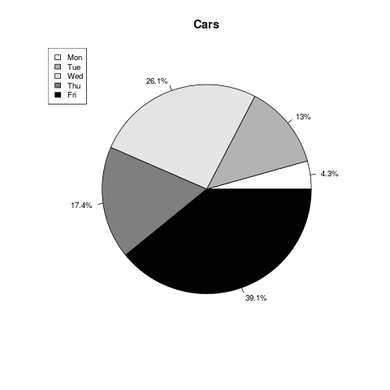


introduction
8.7%
42%
2%
$1,750
Number of IP and ER visits caused by heart disease increased during the past 2 years
Patients with CVD have higher readmission rate.
CMS Valued-Based Purchasing
Provider Pay for Performance Incentives
Early identification and intervention

Slide 4
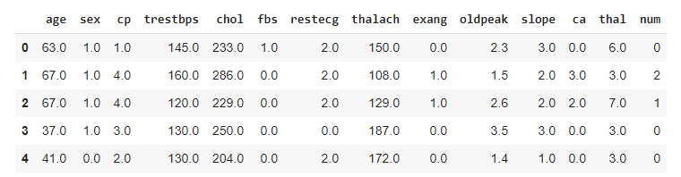
Dataset overview
303 Patient Records;
13 Predictors: Age, Sex, Chest-Pain Type, Resting Blood Pressure, Serum Cholesterol, Fasting Blood Sugar, Resting ECG, Max heart rate, Exercise induced angina, ST depression induced by exercise relative to rest, Peak exercise ST segment, Number of major vessels colored by fluoroscopy, Thalassemia
Predicted: Diagnosis of heart disease (0 = absence; 1,2,3,4 = present)

Slide 5
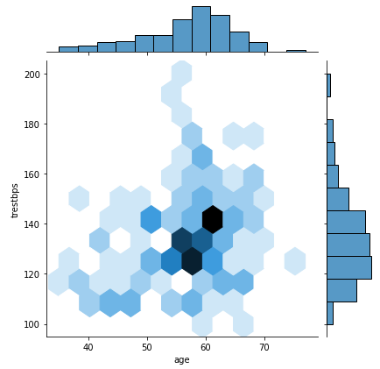
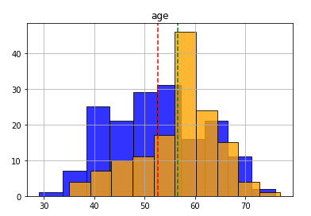
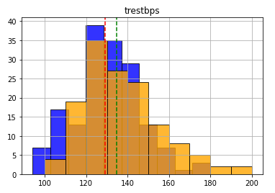
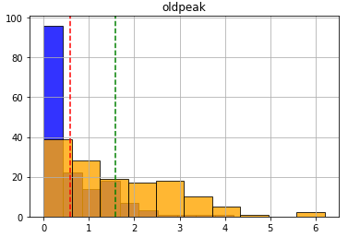
Data Analysis
The average age in disease group is higher and most ofthe cases occur in 55-65 age group.
The average resting BP is higher in disease group.
In disease group, ST depression induced by exercise is
larger.
Non-disease
Disease

Slide 6
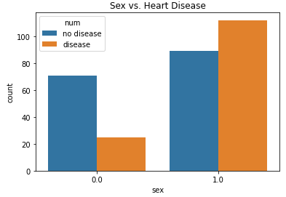
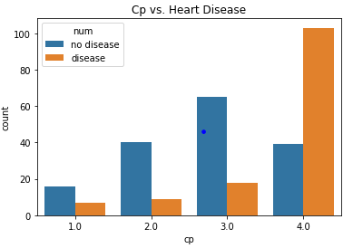
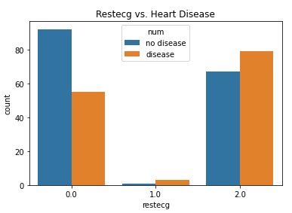
Data Analysis
Sex: 0 being female and 1 being male. Heart disease occur more in males.
For chest pain (1: typical angina, 2: atypical angina, 3: nonanginal pain 4: asymptomatic), most of heart disease cases occur in asymptomatic group.
The group with abnormality with ST-T or left ventricular hypertrophy has more heart disease cases.

Slide 7
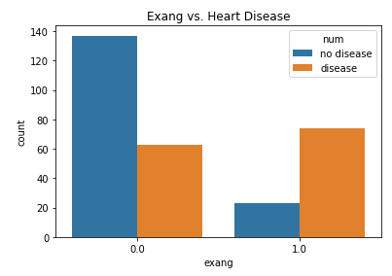
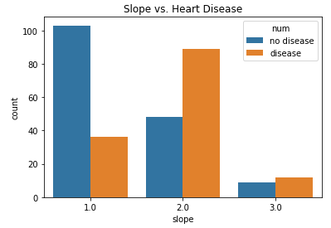
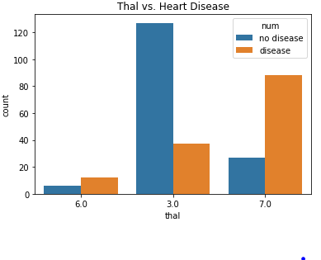
Data Analysis
For exercise induced angina, if yes, the person will be more likely to have heart disease.
There are more heart disease cases in the group with flat or down-sloping ST segment
For thal (3=normal, 6=fixed defect, 7=reversable defect), there are more heart disease cases in thereversable defect group.

Slide 8
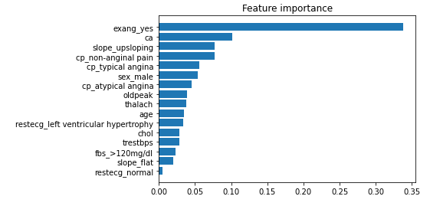
Prediction
Machine Leaning models have been built and tested
Predication accuracy: 0.88
The most impactful indicators of heart disease: Exercise induced Angina, Chest Pain and Peak exercise ST segment

Slide 9


Future Steps
Risk Stratification
EHR Indicators/Flags
Model deployment
Develop risk stratification form
Clinical team assess patients based on the risk factors
Providers are required to provide counseling to patients with higher scores on heart disease prevention and management
Patients with high risk should be indicated or flags on the EHR system
High risk patients should be in one panel in the system and have dedicated staff closely monitor
Work with IT to deploy the model to help predict heart disease for patients
Integrate with EHR

Slide 10

Thank yo

